Slide 1


Machine Learning-Based Approach for Automated Biometric Identification of Mugger
Crocodiles
CSE641 Machine Learning Theory and Practice
Group 5: Shalvi Modi, Daksh Shah, Malav Modi, Mahi Patel, Vinisha Kankariya

Slide 2
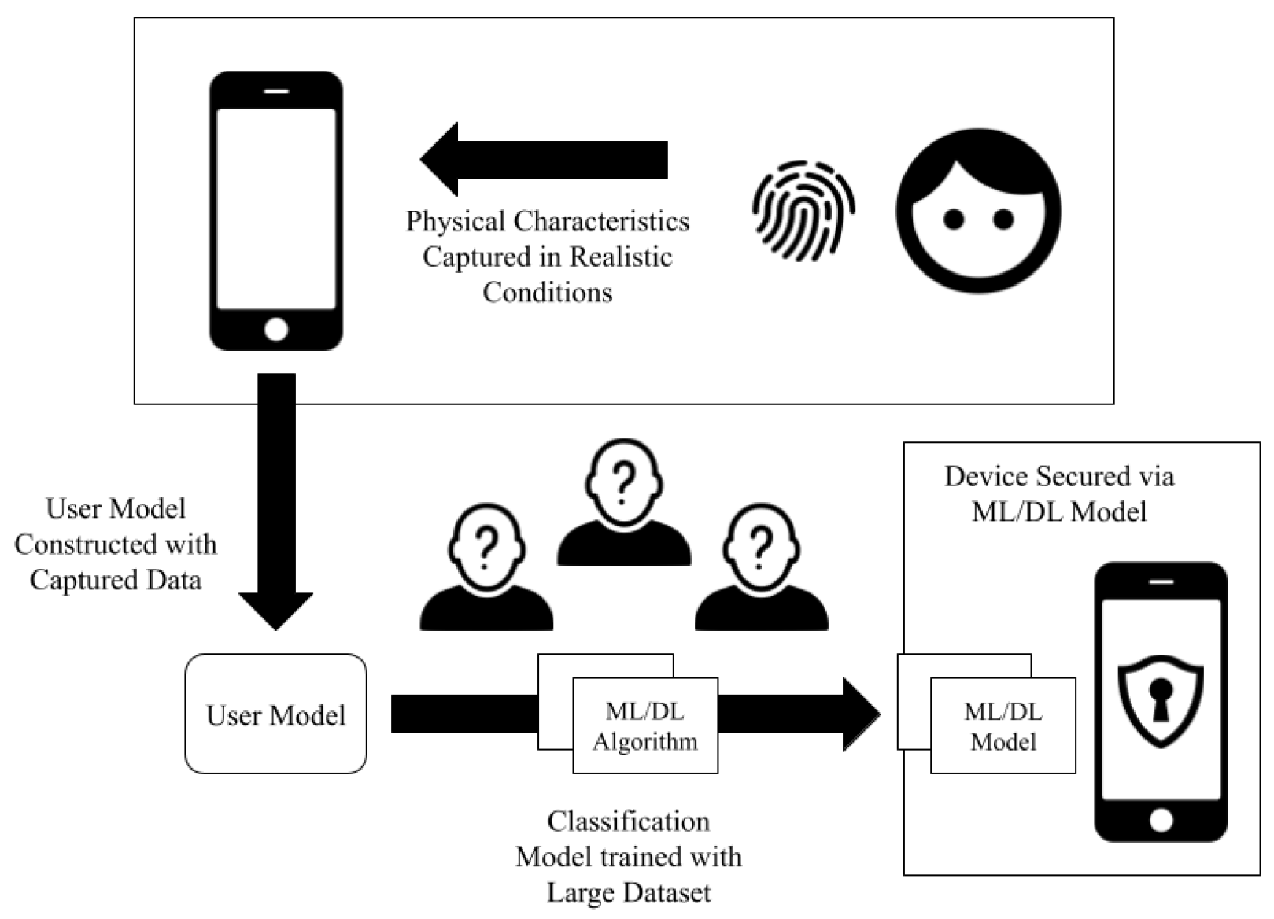
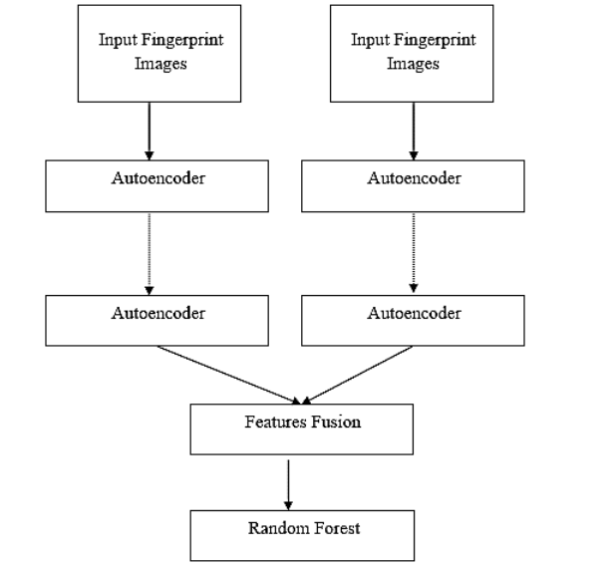

Background
Fig.1 [1]
Fig.2 [2]
[1]Kokal, S., Vanamala, M., & Dave, R. (2023). Deep Learning and Machine Learning, Better Together Than Apart: A Review on Biometrics Mobile Authentication. Journal of Cybersecurity and Privacy, 3(2), 227-258. https://doi.org/10.3390/jcp3020013
[2]Khan, A., & Bhatt, A. Hybrid Biometric Recognition using Stacked Auto Encoder with Random Forest Classifier. aging, 4, 5.

Slide 3
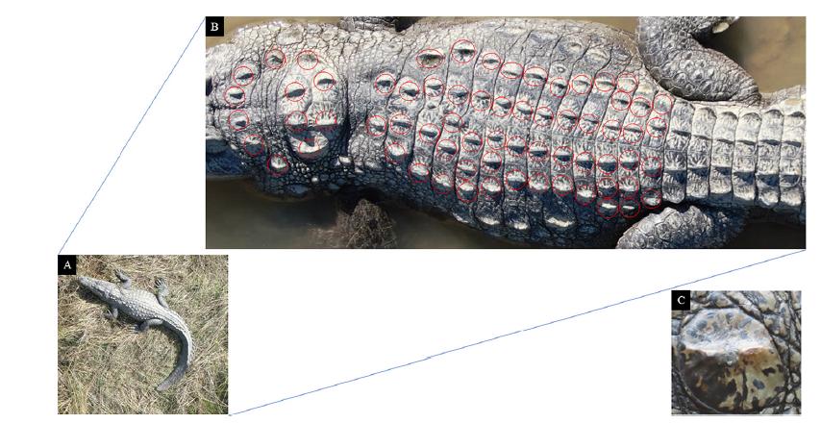
Literature Survey
Machine learning-based biometric identification offers non-invasive alternatives to traditional wildlife tagging. CNNs have been used for species like tigers and chimpanzees, but mostly in controlled environments. Limited research exists on free-ranging crocodilians.
Fig.4 [3]
[3]Ghosal, Ratna & Shah, Supan & Patel, Arpit & Patel, Vaishwi & Raval, Mehul & Desai, Brinky. (2022). Identification of free-ranging mugger crocodiles by applying deep learning methods on UAV imagery. 10.5061/dryad.s4mw6m98n.

Slide 4
Literature Survey
Reference | Method Used | Pros | Relevance
Identification of free-ranging mugger crocodiles by applying deep learning methods on UAV imagery [3] | UAV-based CNN model (YOLO-v5l) for identifying free-ranging mugger crocodiles using dorsal scute patterns. | High accuracy in distinguishing individuals; Non-invasive approach using UAVs; Model showed 89.2% accuracy. | Basis for using UAVs and CNN for crocodile identification in free-ranging environments.
From crowd to herd counting: How to precisely detect and count African mammals using aerial imagery and deep learning?[4] | Deep learning-based remote sensing for wildlife monitoring. | High efficiency in large-scale monitoring; Automates wildlife recognition. | Supports the use of remote sensing and deep learning in animal identification.
Do you get what you see? Insights of using mAP to select architectures of pretrained neural networks for automated aerial animal detection [5] | CNN-based facial recognition for individual identification of primates. | High precision; Works well in controlled conditions. | Demonstrates CNN viability for biometric identification but highlights need for alternative approaches for non-facial species.
Multispecies detection and identification of African mammals in aerial imagery using convolutional neural networks[6] | UAV-based imagery with ML for reptile population estimation. | Effective in identifying large reptiles; UAVs reduce human disturbance. | Reinforces UAV effectiveness for ecological studies on crocodilians.

Slide 5
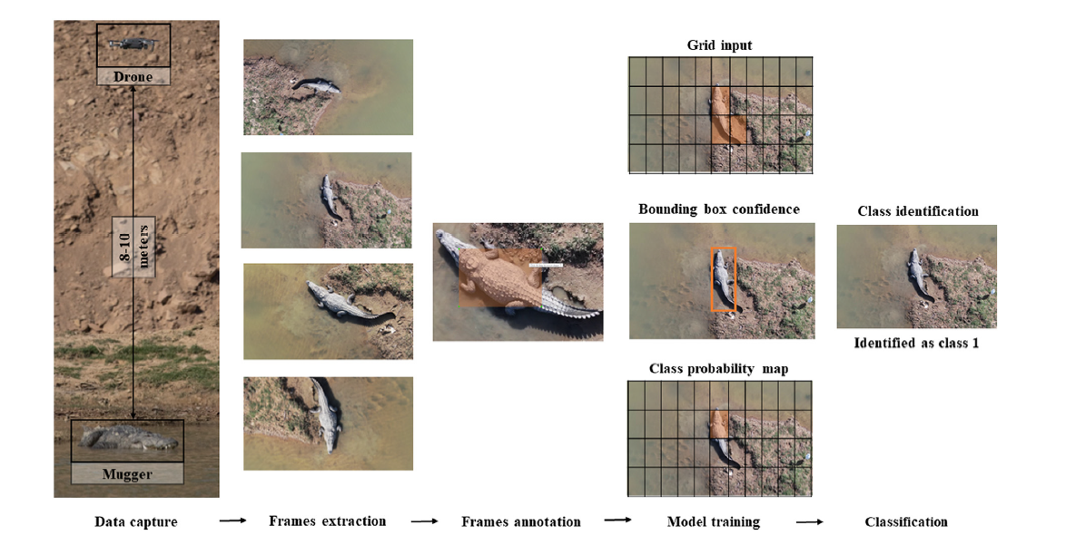
Problem Statement
Using classical machine learning approach for automated biometric identification of Mugger crocodile
Fig.3 [3]
[3]Ghosal, Ratna & Shah, Supan & Patel, Arpit & Patel, Vaishwi & Raval, Mehul & Desai, Brinky. (2022). Identification of free-ranging mugger crocodiles by applying deep learning methods on UAV imagery. 10.5061/dryad.s4mw6m98n.

Slide 6
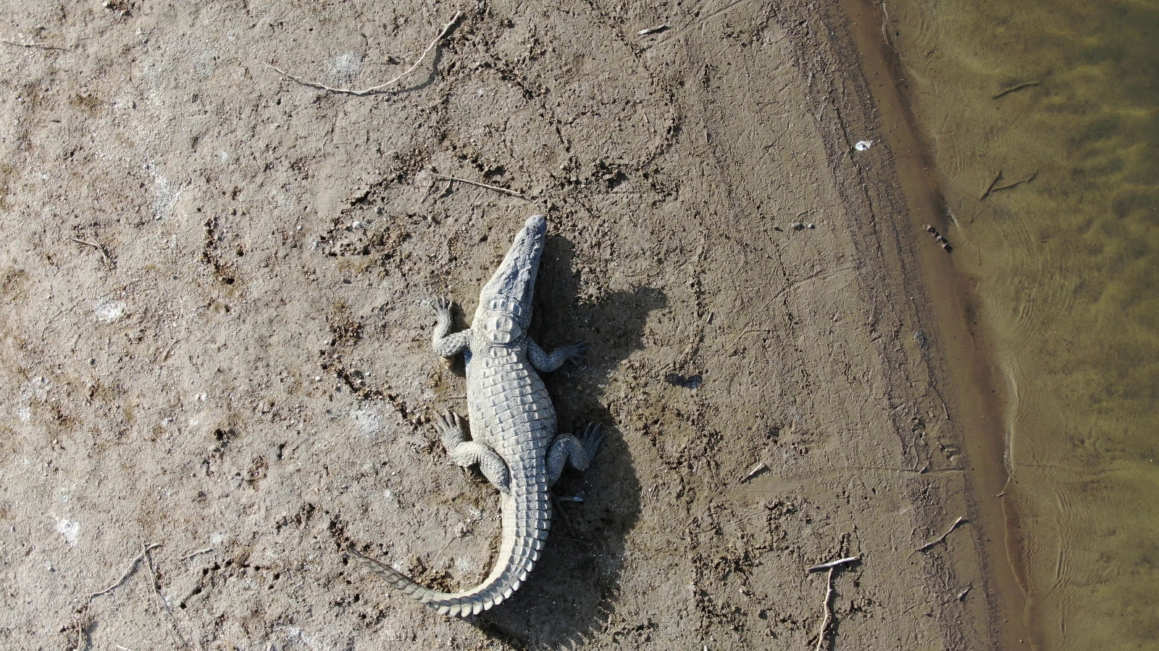
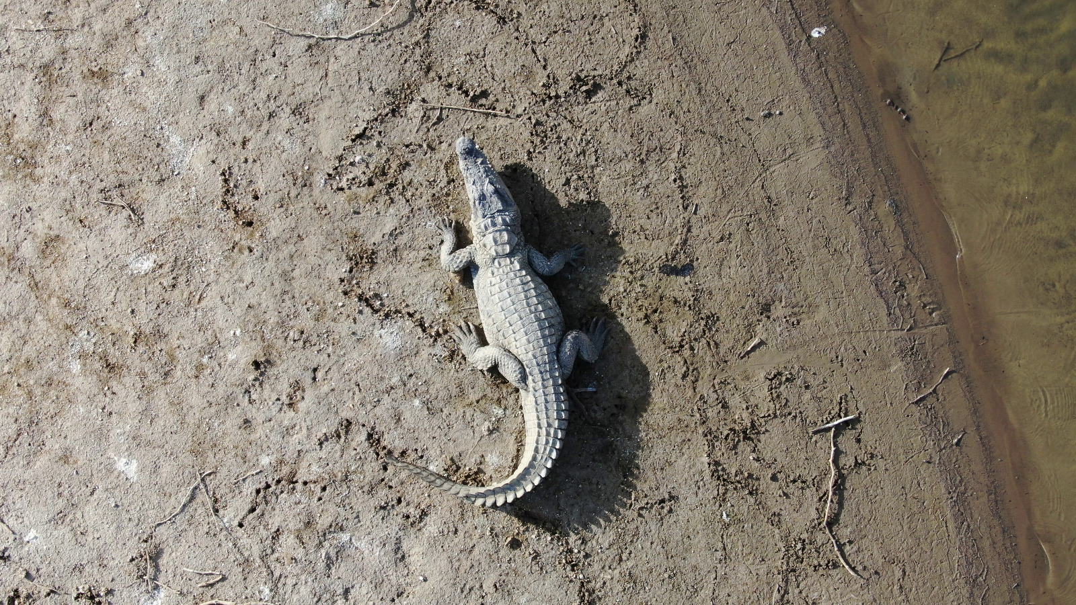
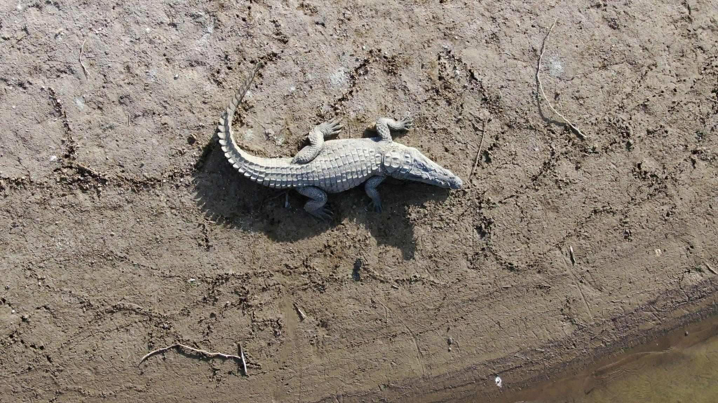
Dataset Discussion
Dataset Size: 88,000 UAV-captured frames
Species: 143 free-ranging mugger crocodiles (~1.5m in length)
Location: 19 locations in Gujarat, India
Drone Used: DJI Mavic 2 Zoom
Camera Specs: 24–48 mm optical zoom
Frame Resolution: 3840 × 2160 pixels at 96 DPI
Flight Height: 8–10 meters
Recording Duration: 30 seconds to 1 minute per session
Flight Pattern: Clockwise rotation
Time of Capture: Between 0800–1600 hours

Slide 7
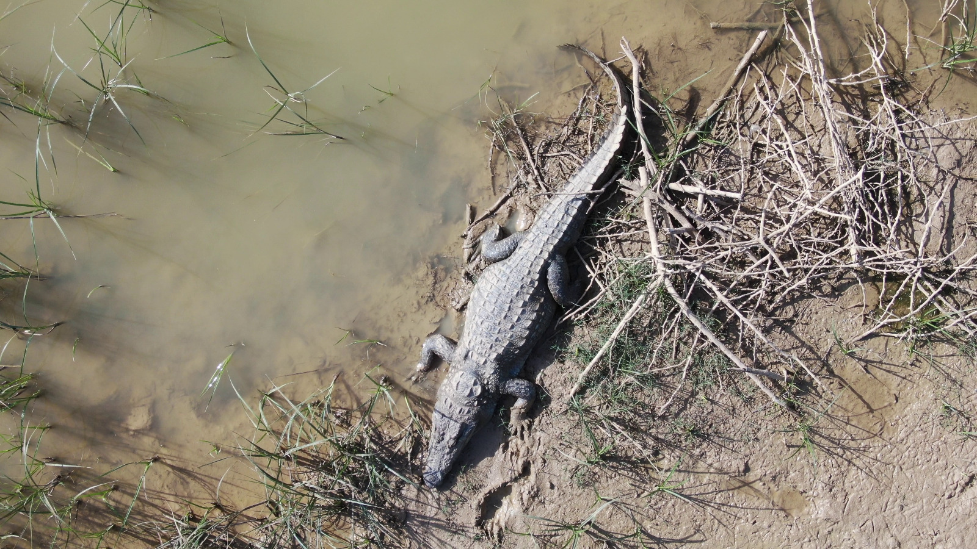
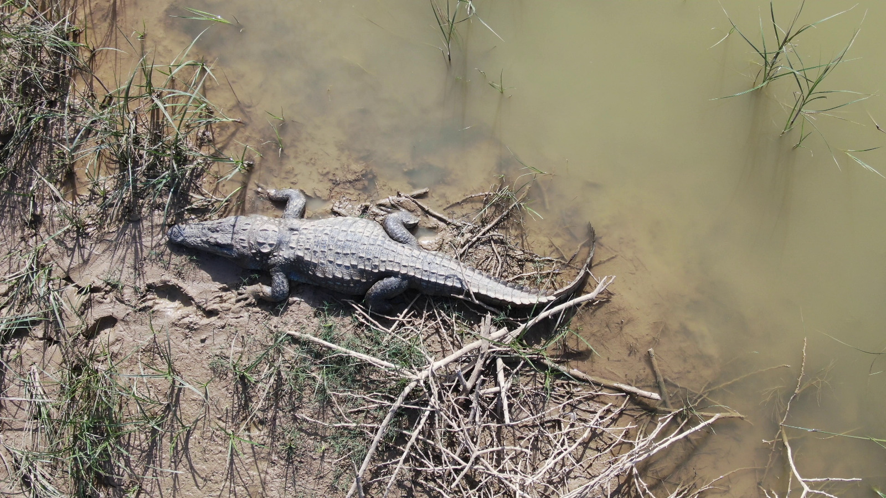
Dataset Discussion
Once a crocodile was spotted, the drone was taken closer to the crocodile focussing on the dorsal scute patterns. OpenCV-Python library used to extract frames from the video clips of 143 muggers.

Slide 8
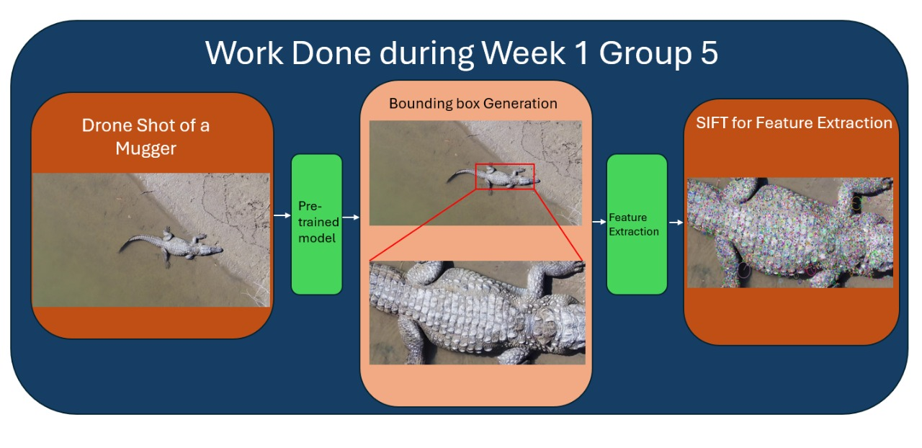
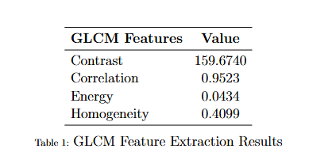
Methodology
We used a pretrained model for bounding box generation, ensuring accurate mugger localization. Feature extraction methods like SIFT,HOG, LBP, GLCM were applied for better identification. A pretrained model was used for bounding box generation.[3]
[3]Ghosal, Ratna & Shah, Supan & Patel, Arpit & Patel, Vaishwi & Raval, Mehul & Desai, Brinky. (2022). Identification of free-ranging mugger crocodiles by applying deep learning methods on UAV imagery. 10.5061/dryad.s4mw6m98n.

Slide 9
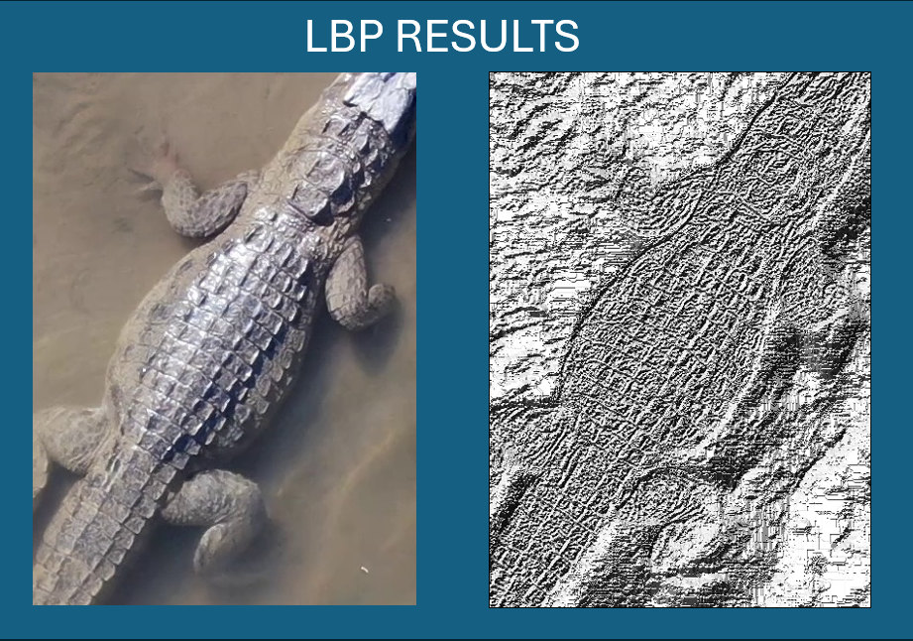
Methodology

Slide 10
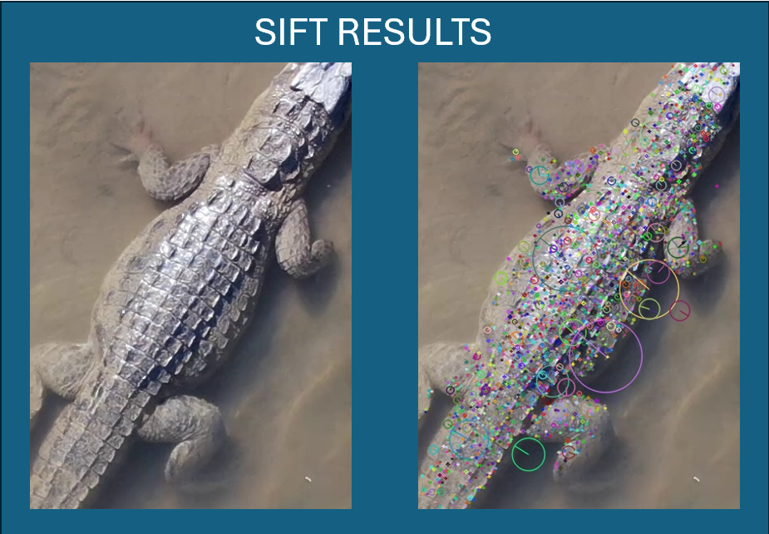
Methodology

Slide 11
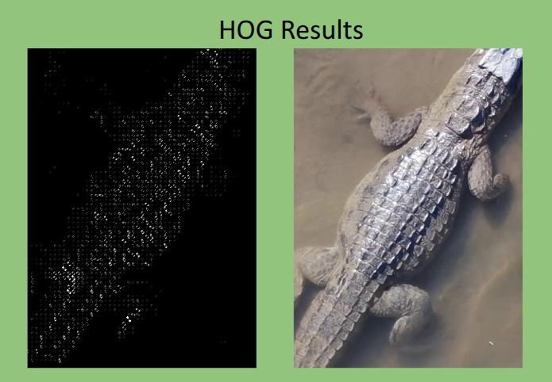
Methodology

Slide 12
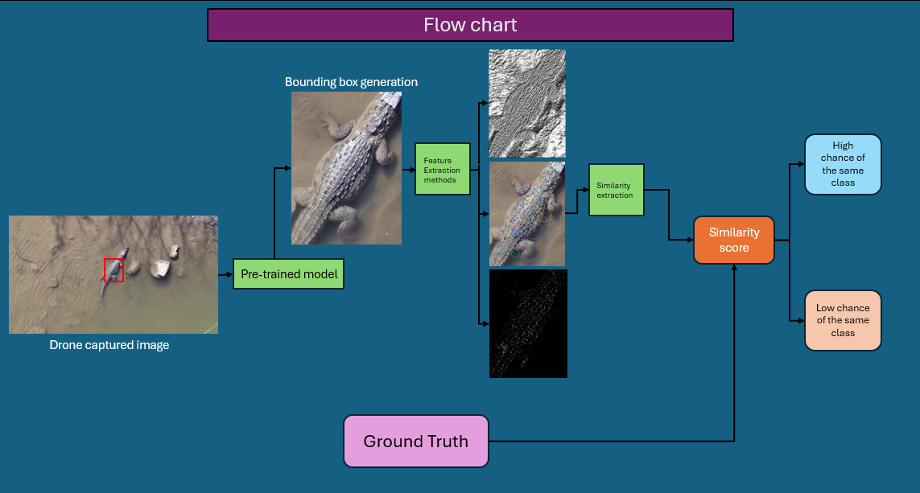
Methodology

Slide 13
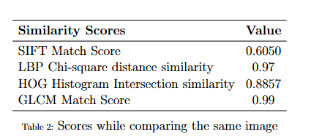
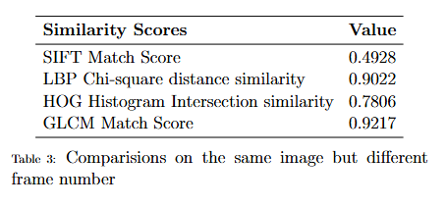
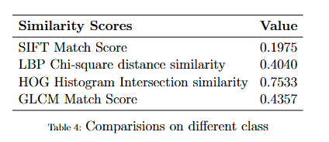
Results

Slide 14
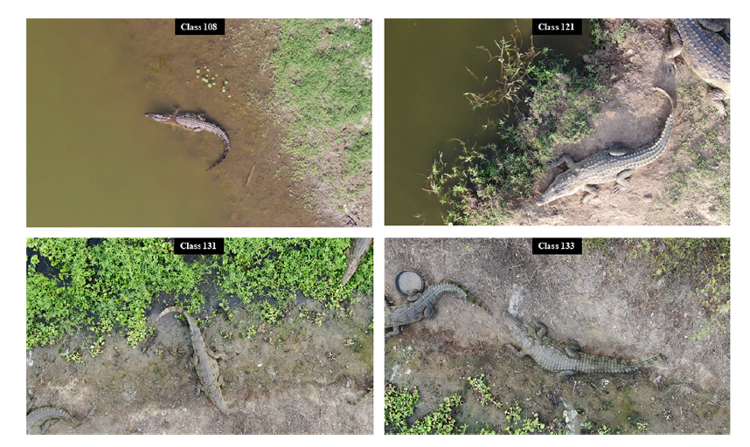
Future Work
We plan to implement a classical machine learning approach for further optimization. The project will focus on two key aspects:
Results on Old Data – This dataset, used in the original study, consists of single-season data and will serve as a benchmark.
Improving TPR on Old + New Data – Our goal is to enhance the True Positive Rate (TPR) by incorporating new multi-season data, improving identification performance across different environmental conditions.
Use ensemble learning approach for future predictions.
Fig.5 [3]

Slide 15
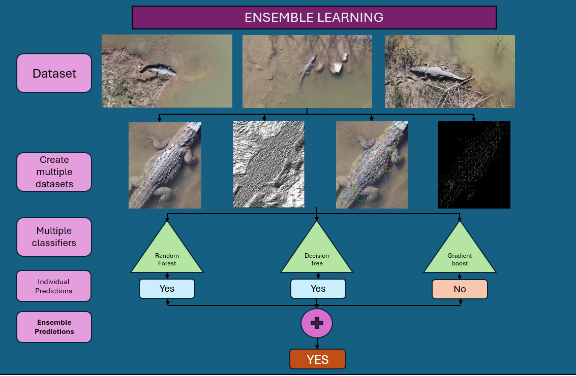
Future Work - Ensemble learning

Slide 16
References
[1]Kokal, S., Vanamala, M., & Dave, R. (2023). Deep Learning and Machine Learning, Better Together Than Apart: A Review on Biometrics Mobile Authentication. Journal of Cybersecurity and Privacy, 3(2), 227-258. https://doi.org/10.3390/jcp3020013
[2]Khan, A., & Bhatt, A. Hybrid Biometric Recognition using Stacked Auto Encoder with Random Forest Classifier. aging, 4, 5.
[3]Ghosal, Ratna & Shah, Supan & Patel, Arpit & Patel, Vaishwi & Raval, Mehul & Desai, Brinky. (2022). Identification of free-ranging mugger crocodiles by applying deep learning methods on UAV imagery. 10.5061/dryad.s4mw6m98n.
[4]Alexandre Delplanque, Samuel Foucher, Jérôme Théau, Elsa Bussière, Cédric Vermeulen, Philippe Lejeune,From crowd to herd counting: How to precisely detect and count African mammals using aerial imagery and deep learning?,ISPRS Journal of Photogrammetry and Remote Sensing,
[5]Moreni, M., Theau, J., & Foucher, S. (n.d.). Do you get what you see? insights of using map to select architectures of pretrained neural networks for automated aerial animal detection. PLOS ONE. https://journals.plos.org/plosone/article?id=10.1371%2Fjournal.pone.0284449
[6]Multispecies detection and identification of African mammals in aerial imagery using convolutional neural networks - Delplanque - 2022 - remote sensing in ecology and Conservation - Wiley Online Library. (n.d.). https://zslpublications.onlinelibrary.wiley.com/doi/10.1002/rse2.234

